Slide 1
OPIM 5604
Predictive Modeling
Neural Networks
Jennifer Eigo, Instructor in-Residence

Slide 2
Basic Idea
Combine input information in a complex and flexible neural net “model”
Model “coefficients” are continually tweaked in an iterative process
The network’s interim performance in classification and prediction informs successive tweaks

Slide 3
Network Structure
Multiple layers
  Input layer (raw observations)
  Hidden layers
  Output layer
Nodes
Weights (like coefficients, subject to iterative adjustment)
Bias values (like intercepts, subject to iterative adjustment)

Slide 4
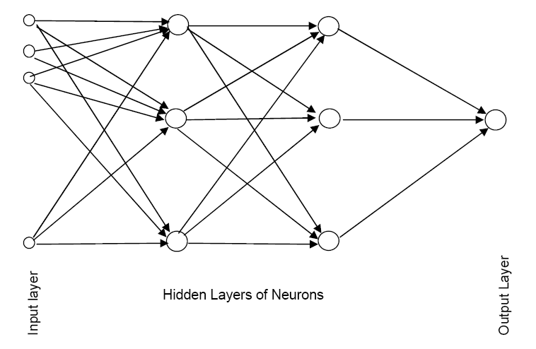
Schematic Diagram

Slide 5
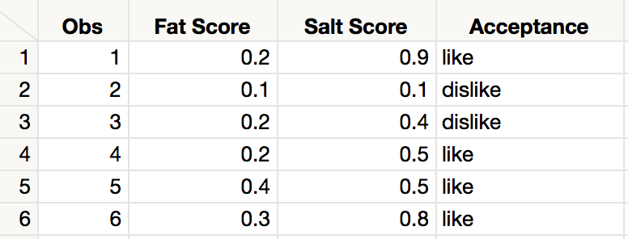
Tiny Example
Using fat and salt content to predict consumer acceptance of cheese

Slide 6
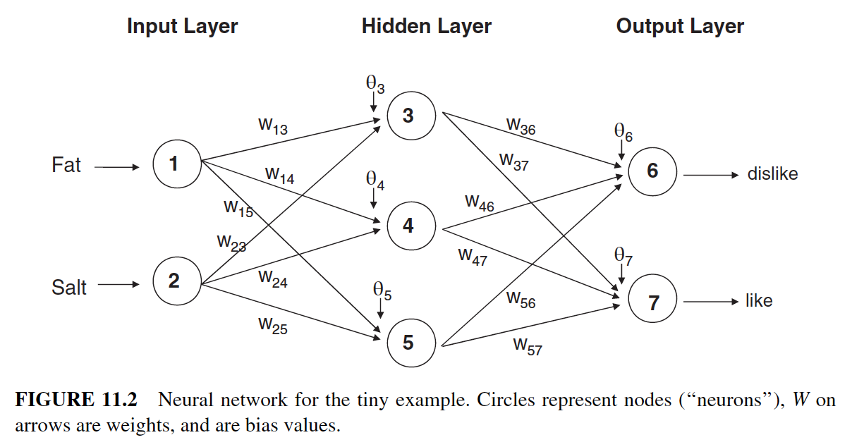
Tiny Example Neural Network

Slide 7
Moving Through the Network

Slide 8
The Input Layer
For input layer, input = output
E.g., for record #1:
  Fat input = output = 0.2
  Salt input = output = 0.9
Output of input layer = input into hidden layer

Slide 9

The Hidden Layer
In this example, hidden layer has 3 nodes
Each node receives as input the output of all input nodes
Output of each hidden node is a function of the weighted sum of inputs
(The hidden layer function is also called an ”activation function”.)

Slide 10
The Weights
The weights θ (theta) and w are typically initialized to random values
Equivalent to a model with random prediction (in other words, no predictive value)
These initial weights are used in the first round of training

Slide 11
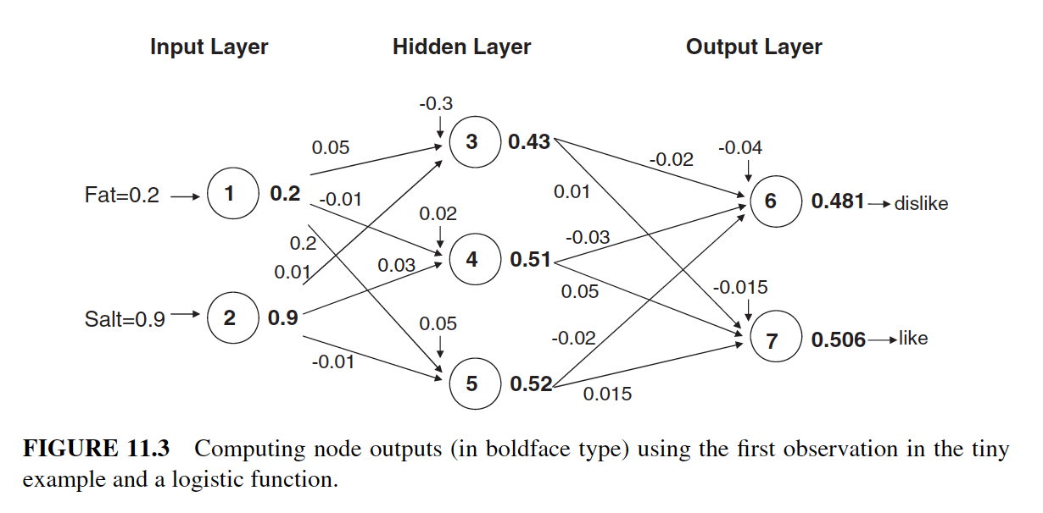
Tiny Example Neural Weights

Slide 12
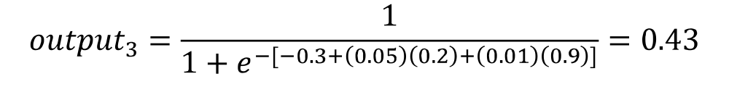
Output of Node 3, if g is a Logistic Function

Slide 13
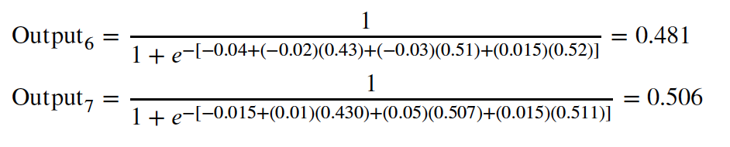
Output Layer
The output of the last hidden layer becomes input for the output layer
Uses same function as above, i.e. a function g of the weighted average

Slide 14
Tiny Example Output Layer

Slide 15
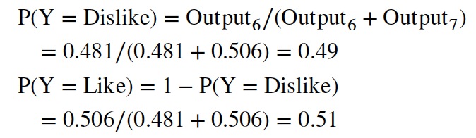
Mapping the output to a classification
These values are normalized so they are propensities (which add up to 1.0).
The default cutoff for classification is 0.5.
This first record would be classified as a Like.

Slide 16

Relation to Linear Regression
A net with a single output node and no hidden layers, where g is the identity function, takes the same form as a linear regression model

Slide 17
Training the Model

Slide 18
Initial Pass Through Network
Goal: Find weights that yield best predictions
The process we described above is repeated for all records
At each record, compare prediction to actual
Difference is the error for the output node
Error is propagated back and distributed to all the hidden nodes and used to update their weights
Learning rate controls how much weights are updated each time

Slide 19
Why It Works
Big errors lead to big changes in weights
Small errors leave weights relatively unchanged
Over thousands of updates, a given weight keeps changing until the error associated with that weight is negligible, at which point weights change little

Slide 20
Case Updating
Weights are updated after each record is run through the network
Completion of all records through the network is one epoch (also called sweep or iteration)
After one epoch is completed, return to first record and repeat the process

Slide 21
Batch Updating
All records in the training set are fed to the network before updating takes place
In this case, the error used for updating is the sum of all errors from all records
A variant of this is mini-batch updating

Slide 22
Common Criteria to Stop the Updating
When weights change very little from one iteration to the next
When the misclassification rate reaches a required threshold
When a limit on runs is reached

Slide 23
User Inputs

Slide 24
Specify Network Architecture
Number of hidden layers
  Most popular – one to two hidden layer
Number of nodes in hidden layer(s)
  More nodes capture complexity, but increase chances of overfit
Learning Rate
  Low values “downweight” the new information from errors at each iteration
  This slows learning, but reduces tendency to overfit to local structure

Slide 25
Advantages
Good predictive ability
Can capture complex relationships
No need to specify a model

Slide 26
Disadvantages
Considered a “black box” prediction machine, with no insight into relationships between predictors and outcome
No variable-selection mechanism, so you have to exercise care in selecting variables
Heavy computational requirements if there are many variables

Slide 27
Summary
Neural networks can be used for classification and prediction
Can capture a very flexible/complicated relationship between the outcome and a set of predictors
The network “learns” and updates its model iteratively as more data are fed into it
Major danger: overfitting
Requires large amounts of data
Good predictive performance, yet “black box” in nature

Slide 28
References
NN images retrieved from:
Shmueli, G. (2023). Machine Learning for Business Analytics: Concepts, Techniques and Applications with JMP Pro 2nd Edition. Hoboken, NJ: Wiley.

